Slide 1
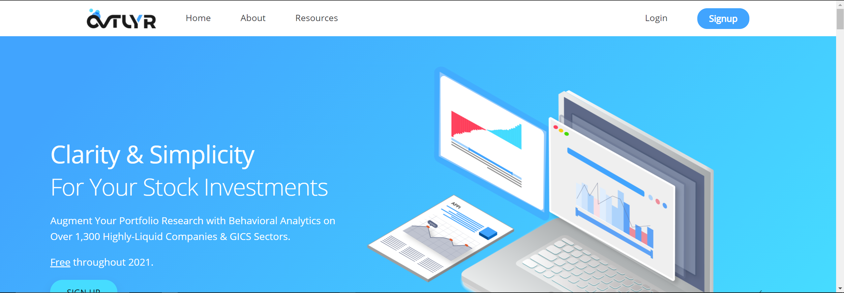
Still some banner cutoff (screenshot of double-width monitor).
APPI is a penny stock. Can we get a different symbol here?
Closer-to-even length text:
Augment Your Portfolio Research with Behavioral Analytics
On Over 1,300 Highly-Liquid Companies & GICS Sectors.

Slide 2
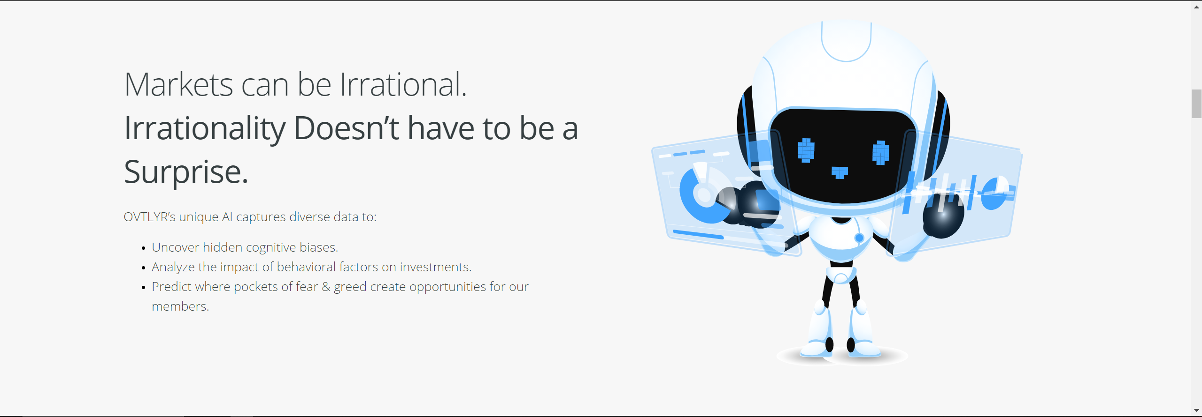
Can we blend shadows into background color?
We have arrows instead of bullets on “hardhat” section below. Let’s use the same here for consistency.

Slide 3
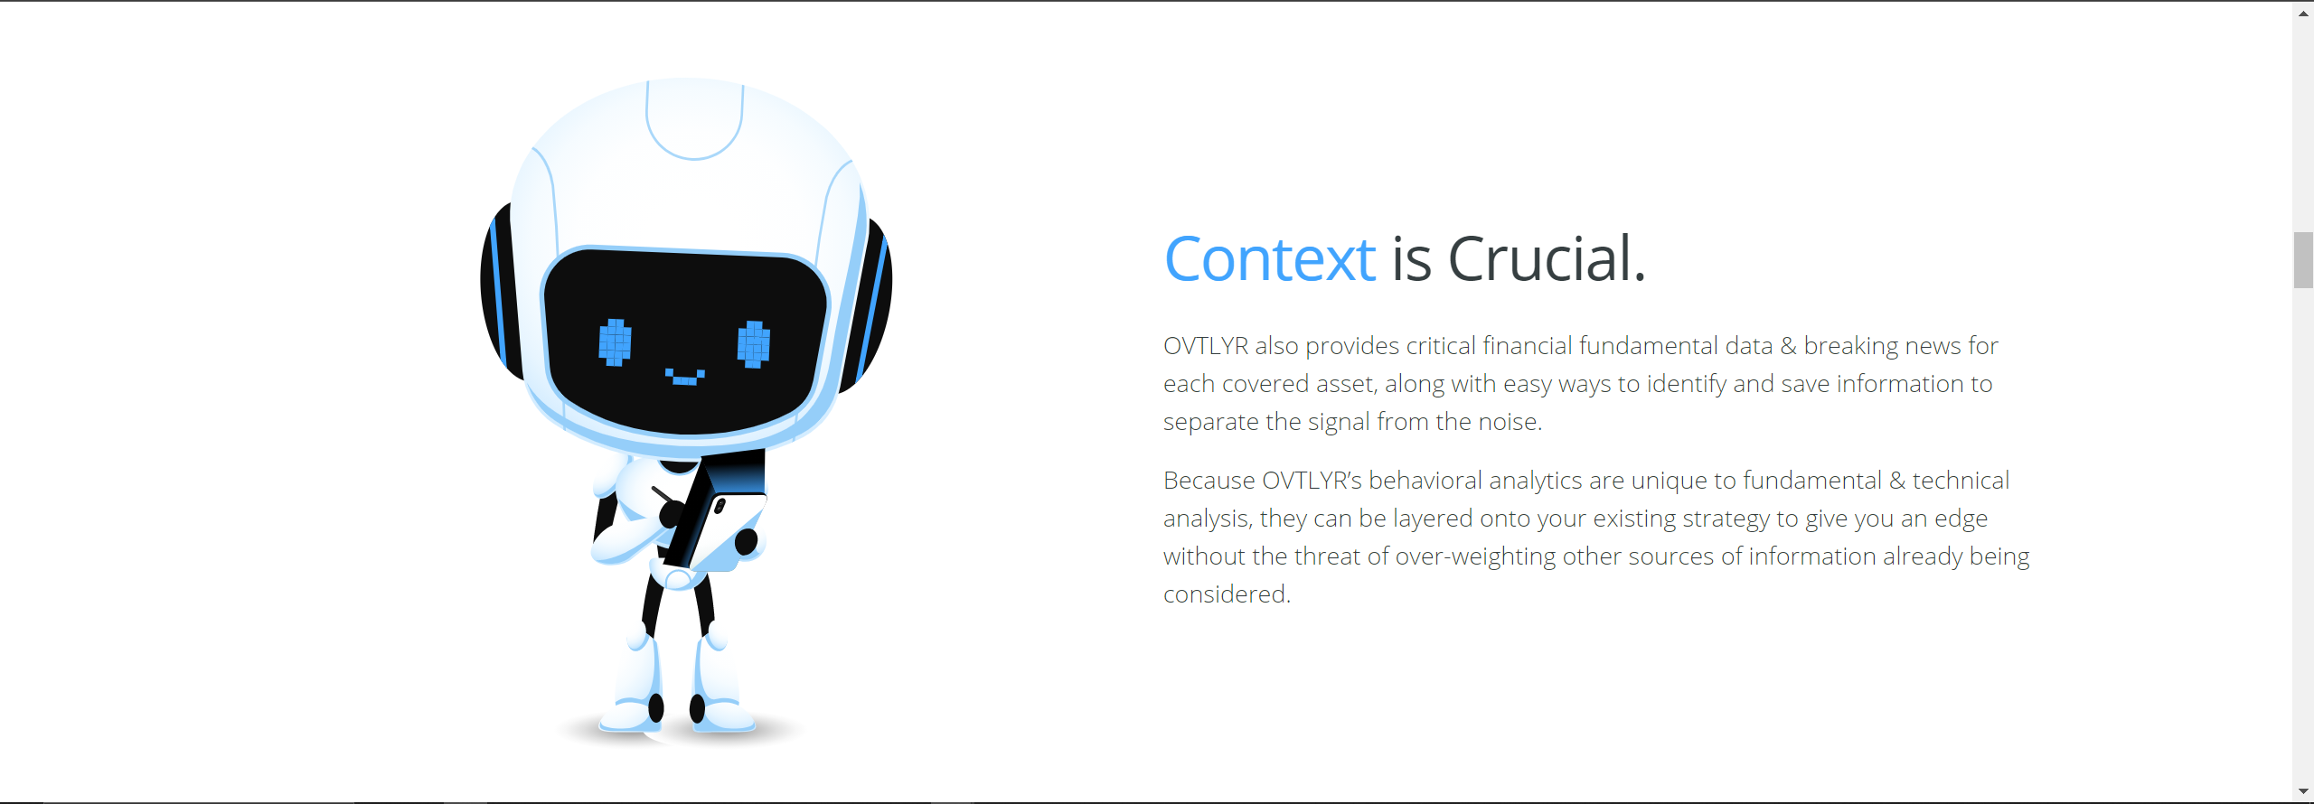
Can we remove shading coming off tablet screen?
Double-check text:
OVTLYR also provides financial data & breaking news, along with easy ways to identify and save relevant information helping to separate the signal from noise.
OVTLYR’s behavioral analytics are unique to fundamental & technical analysis. They can be layered onto existing strategies without the threat of over-weighting traditional sources.

Slide 4
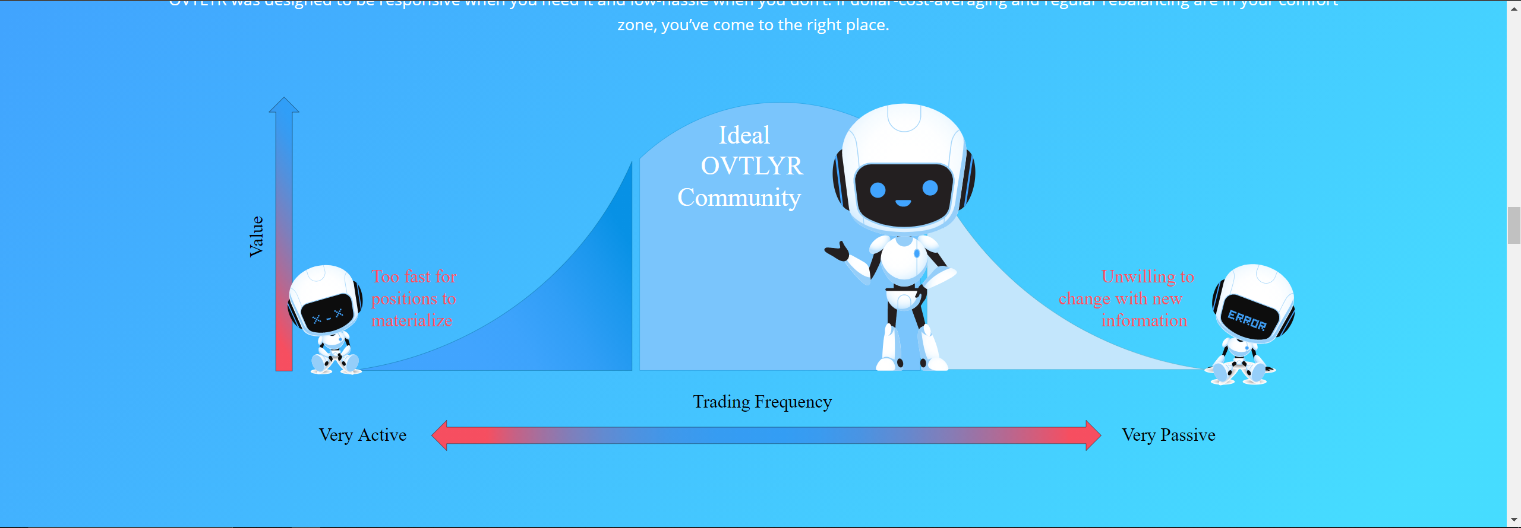
Test red faces on side robots; also double-check evenness of their placement and respective side texts. If shading (under feet/hands) can match background it would be best.
Make blue areas of arrows white (or another color visible with blue background).
Center text on chart peak (slide robot right if needed).
Closer-to-even length text:
Members who are neither highly active nor completely passive have the most to gain. These are the investors too busy to
take on the lifestyle of a full-time trader but are also dissatisfied with holding through pronounced downturns in the market.
OVTLYR was designed to be responsive when you need it and low-hassle when you don’t.
If dollar-cost-averaging and regular rebalancing are in your comfort zone, you’ve come to the right place.

Slide 5
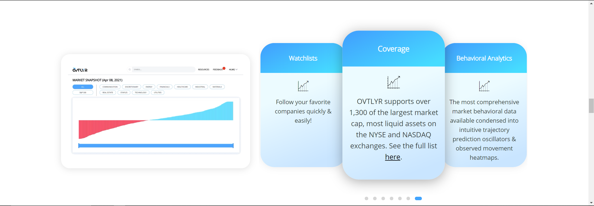
Can we get different icons for each bullet in rotation?
I can get to work on new video slides once I have updated screenshots for each section.

Slide 6
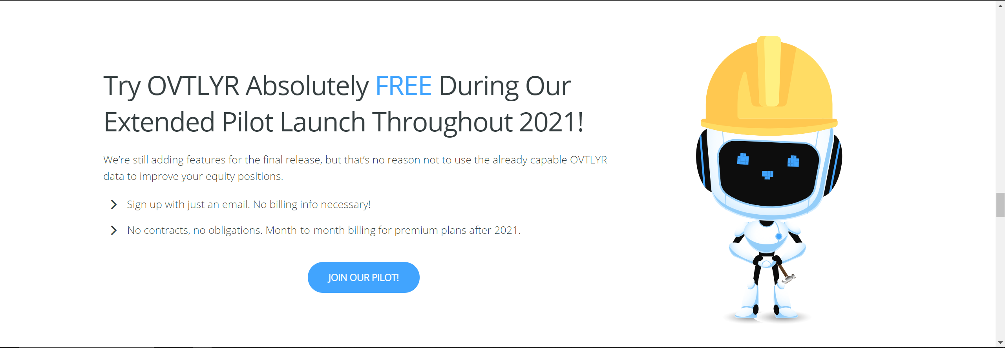
Test squishing the hardhat a little bit (less height, same width); possibly also rotate to fit head angle?

Slide 7
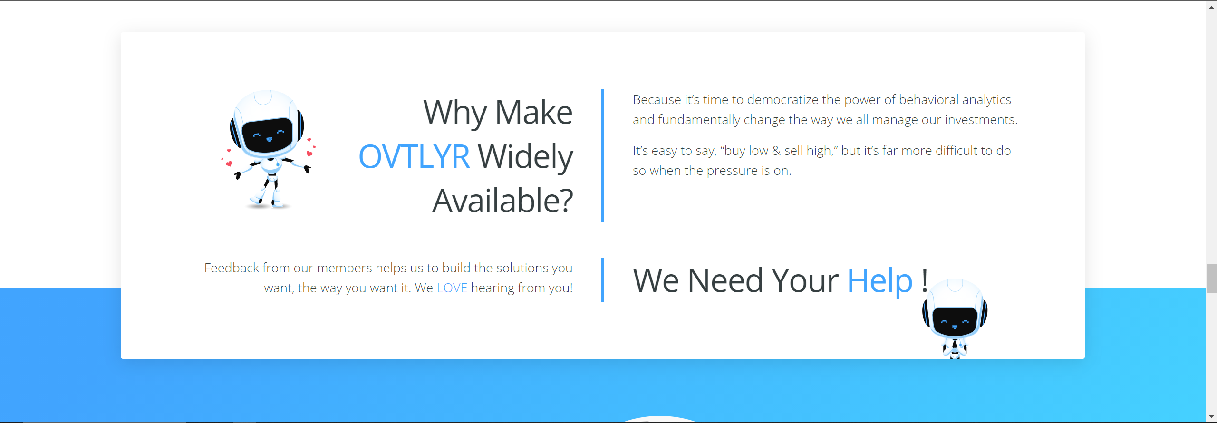
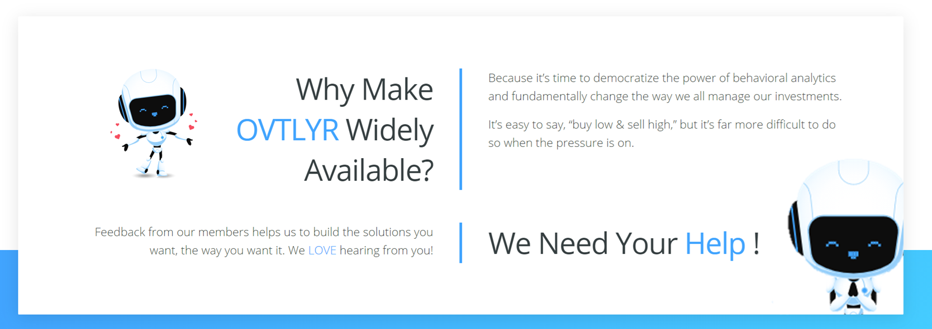
Slide this guy over to the right a touch to make sure he doesn’t get in the way of text. Maybe also increase his size to make hands more visible.
Sample.

Slide 8
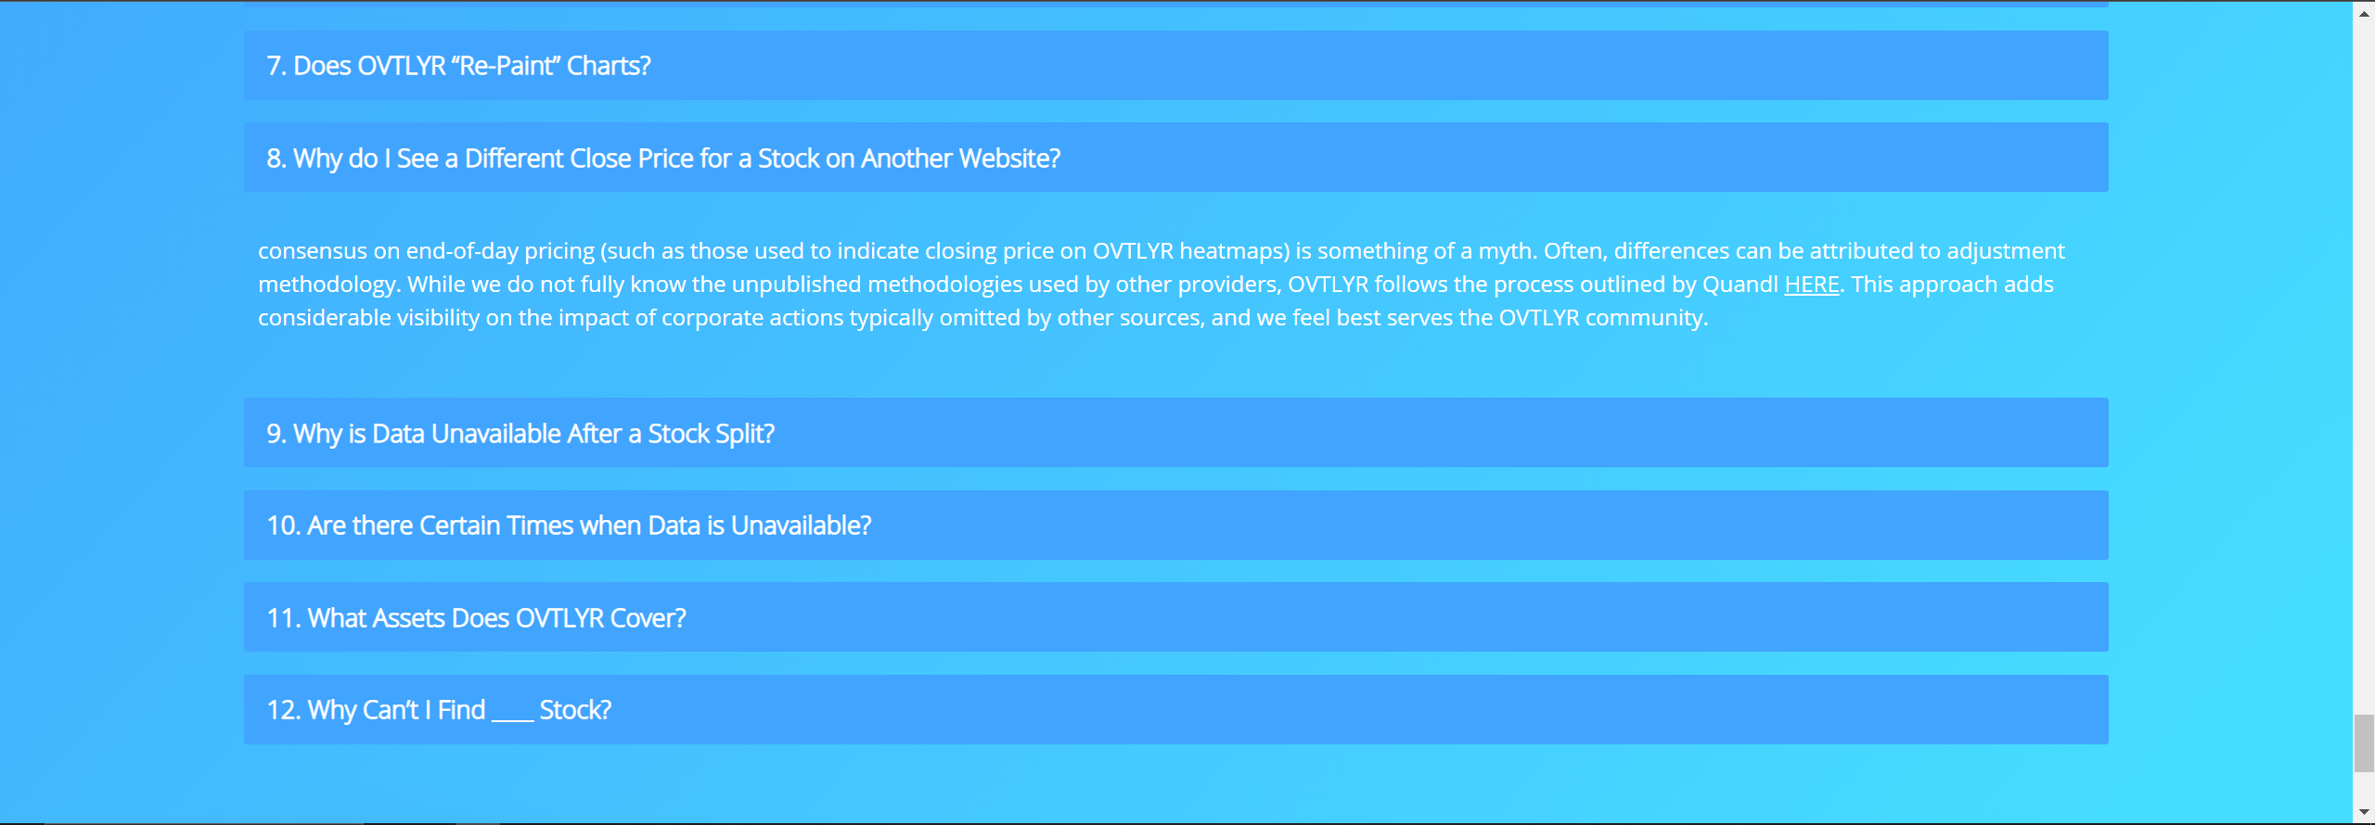
Indent FAQ response text on L/R edges.
Double-check FAQ text.
Remove #10 pending update.

